Slide 1
Upset Potential in the National Football League (NFL)
Mary J. Snyder
Advisor: Michael P. McGuire Ph.D.

Slide 2
Agenda
Introduction
Dataset
Experiment Design, Tools, & Approaches
Results
Conclusion

Slide 3
Introduction
Background
Abstract
Determining factors that influence the potential for upsets in the NFL
Objectives
Fun applications
Fantasy Football
Spread or confidence point picks leagues
Team preparation
Identify steps to protect themselves
Focus their training to upset other teams

Slide 4
Dataset
Data attribute selection
Game information
Team, score, outcome, week
Statistics related
Injuries, average points for, average points against
Outside influence
Weather, time zone, time of games, number of days rest between games
Challenges
Injuries per position
Weather
Game time
Sources
Historical databases, NFL.com, weather databases

Slide 5
Experiment Design, Tools, & Approaches
Data Analysis
Preprocessing, Scatterplots, Histograms
Magnitude of Upset
Clustering
DBSCAN, K-Means
Classification
Naïve Bayes, Decision Tree
Upset
Classification
Decision Tree
Past years to predict current year
Holdout method - 70/30 split
Notes:
Preprocessing: Weather, Average Points For/Against, Magnitude of Upset

Slide 6
Results
Data Analysis
Magnitude of Upset (UpsetAmt)
Upset

Slide 7
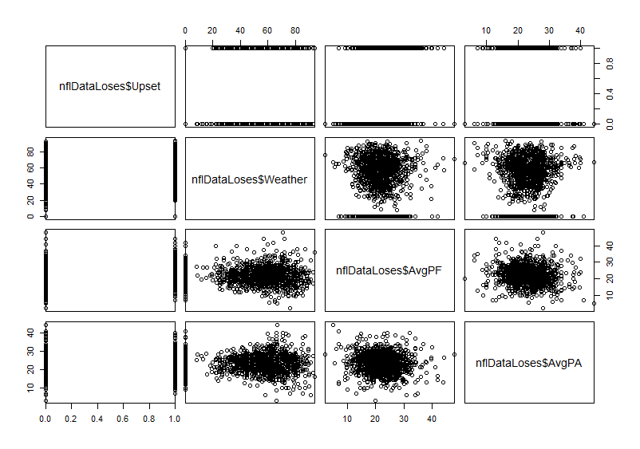
Results: Data Analysis (1 of 2)

Slide 8
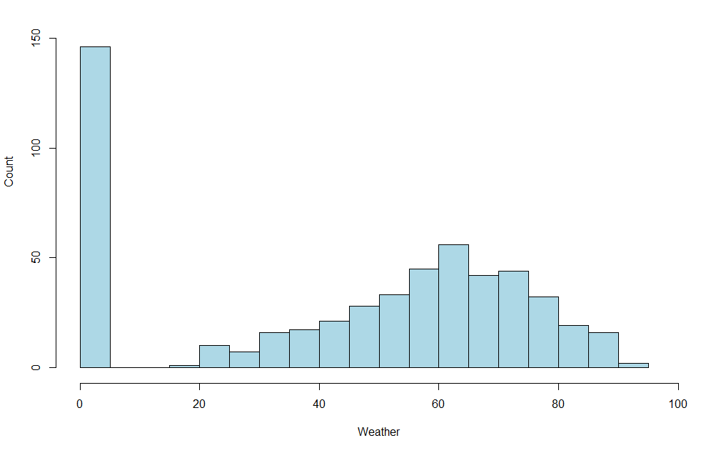
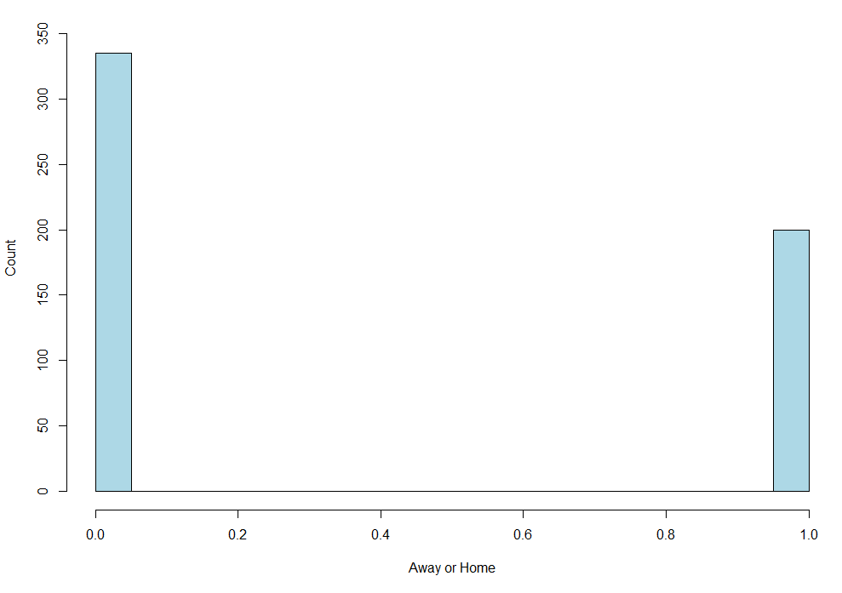
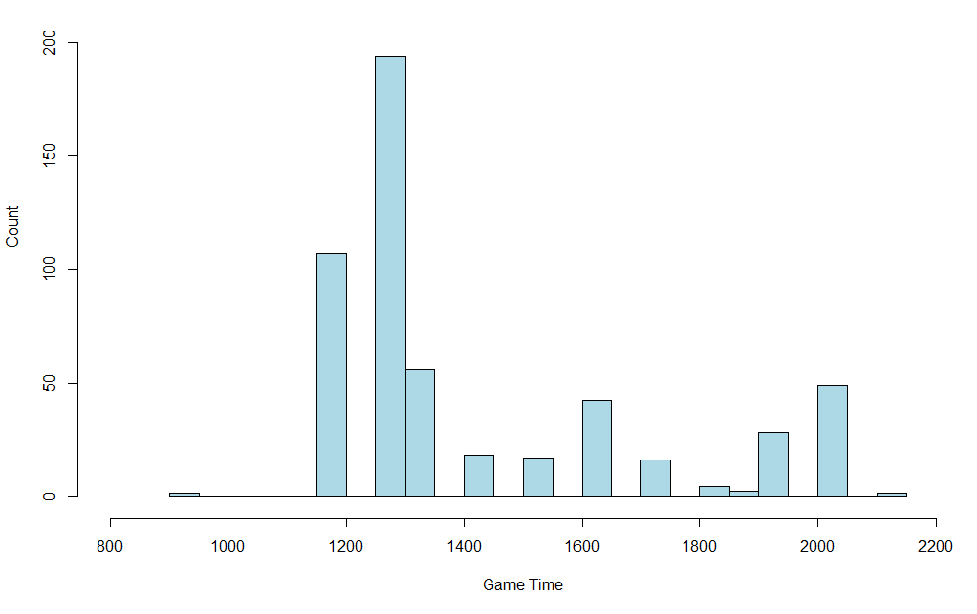
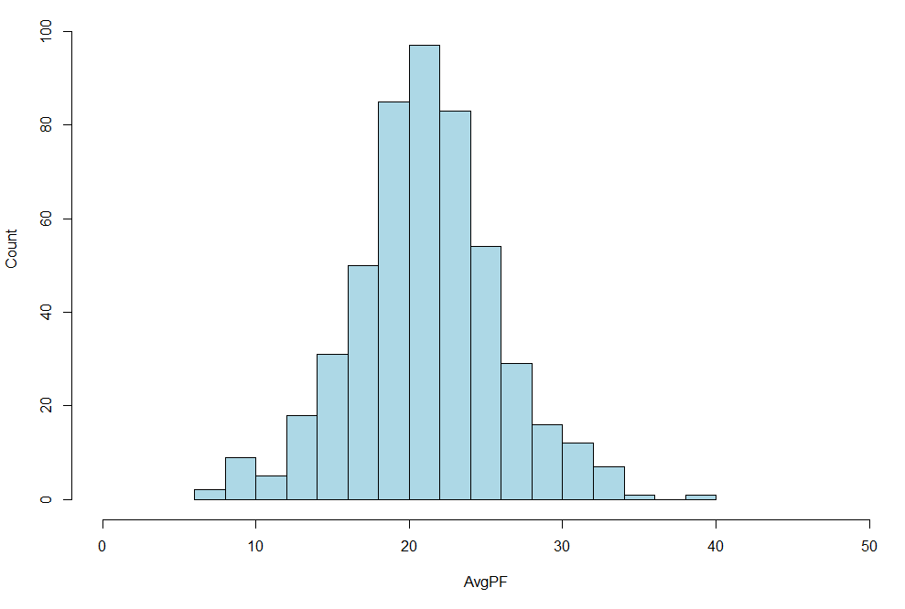
Results: Data Analysis (2 of 2)
Notes:
Top Left: Histogram of Upset Wins Weather
Bottom Left: Histogram of Upset Wins Game Time
Top Right: Histogram of Upset Wins Away (0) or Home (1)
Bottom Right: Histogram of Upset Wins Average Points For

Slide 9
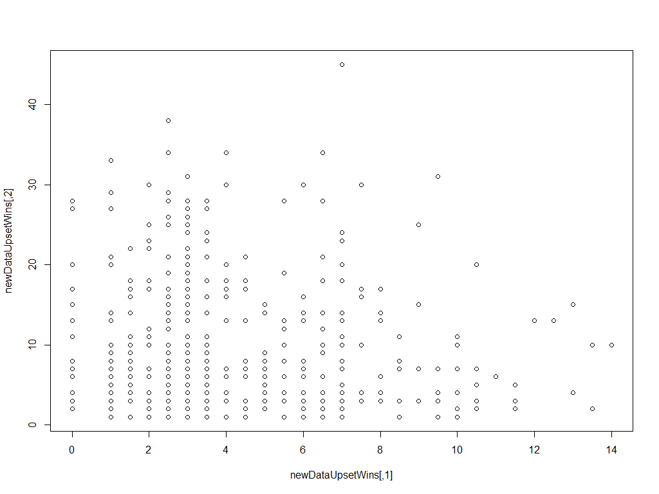
Results: Magnitude of Upset – Clustering
Notes:
Before any clustering algorithms … Odds vs UpsetAmt

Slide 10
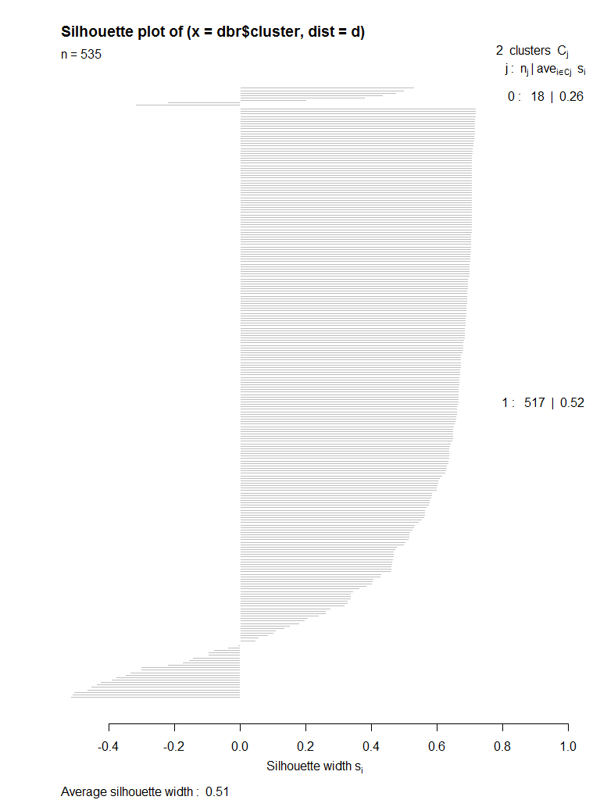
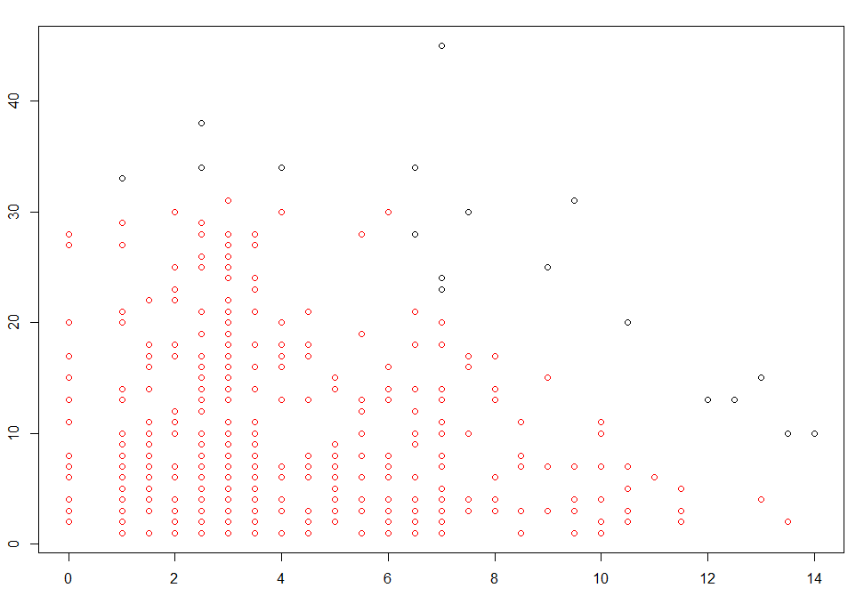
Results: Magnitude of Upset – Clustering with DBSCAN
Notes:
2 clusters … red and black
A few outliers

Slide 11
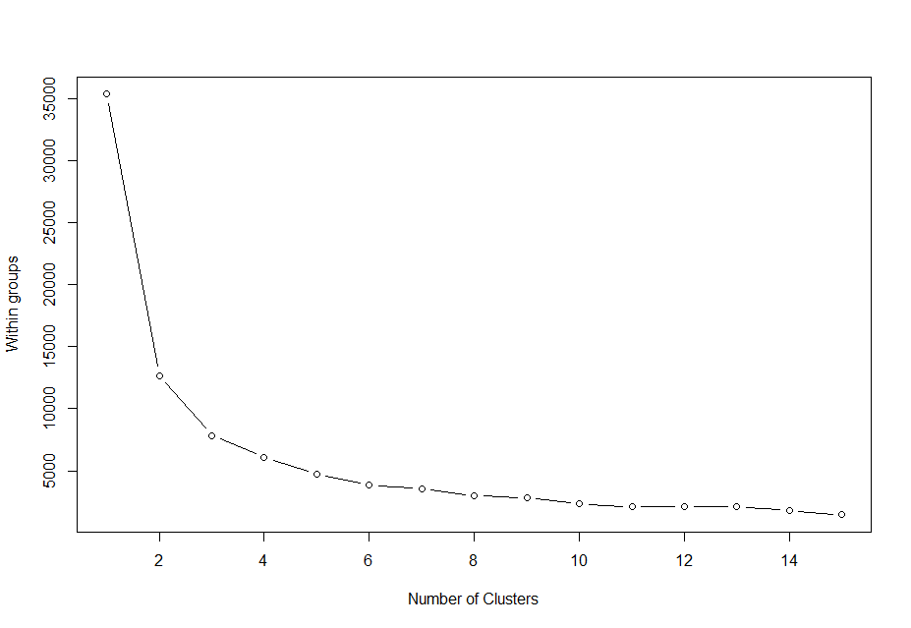
Results: Magnitude of Upset – Clustering with K-Means (1 of 3)

Slide 12
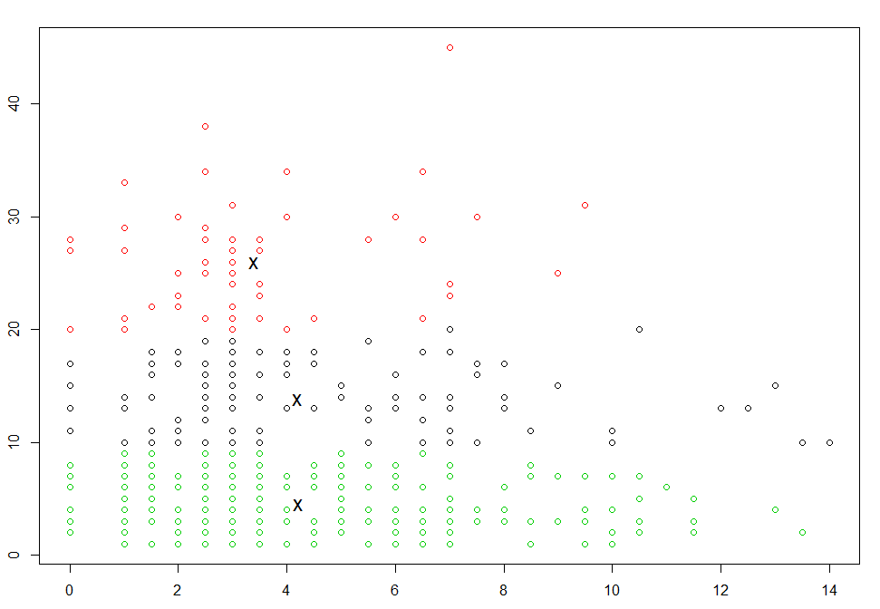
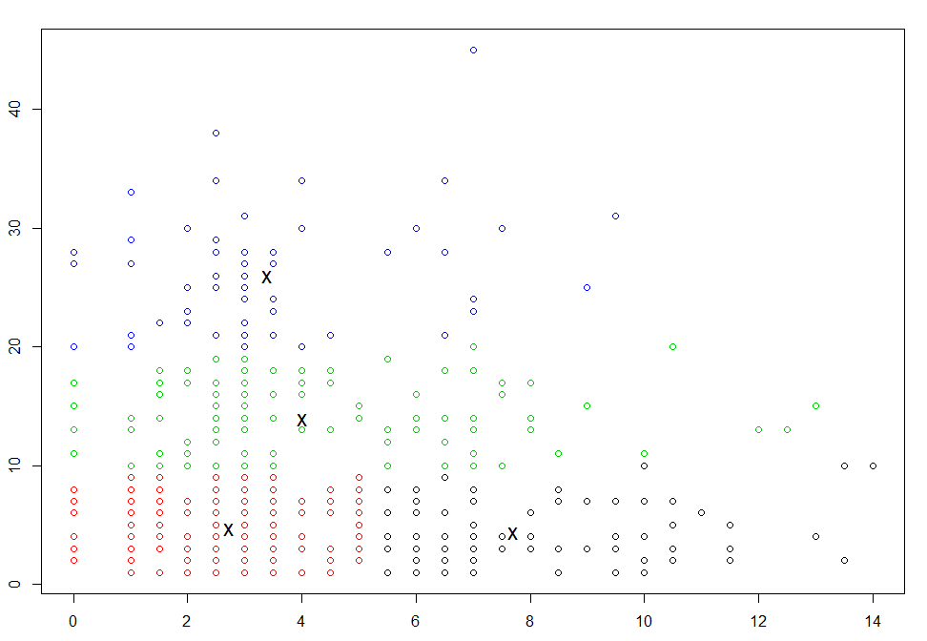
Results: Magnitude of Upset – Clustering with K-means (2 of 3)
K-Means Clustering k=3
K-Means Clustering k=4

Slide 13
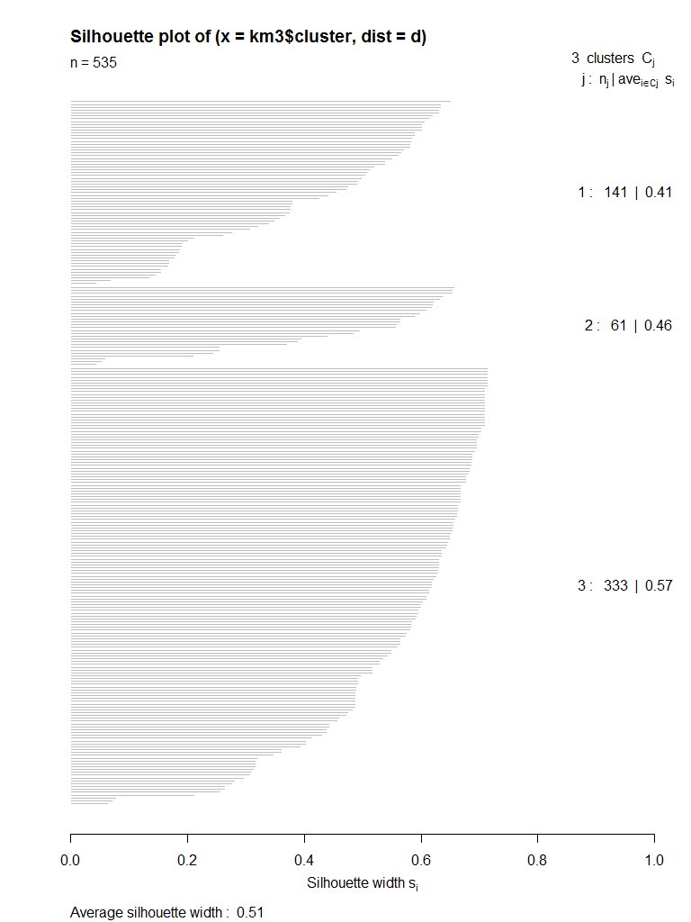
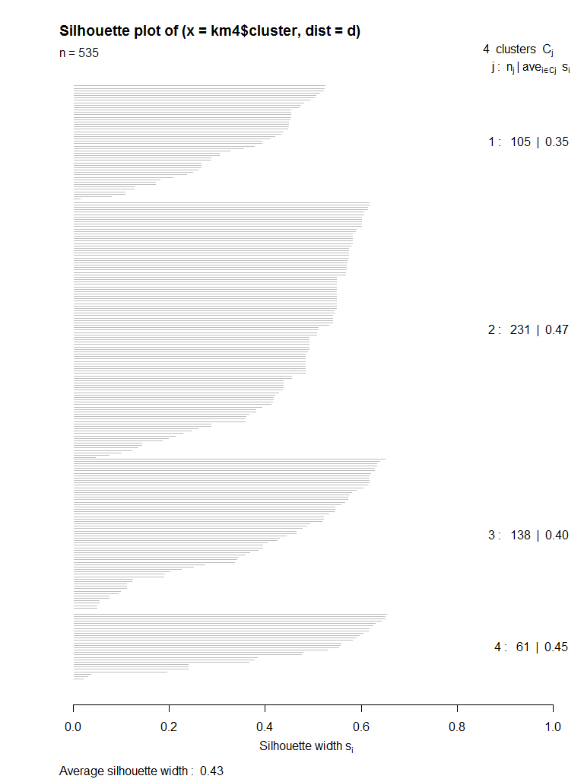
Results: Magnitude of Upset – Clustering with K-means (3 of 3)
K-Means Clustering k=3
K-Means Clustering k=4

Slide 14
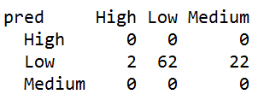
Results: Magnitude of Upset – Classification with Naïve Bayes
Naïve Bayes:
Classifier:
Upset Amount (UpsetAmt)
Parameters:
Away or Home (AorH)
Game Time (Time)
Game Weather (Weather)
Average Points For (AvgPF)
Average Points Against (AvgPA)

Slide 15
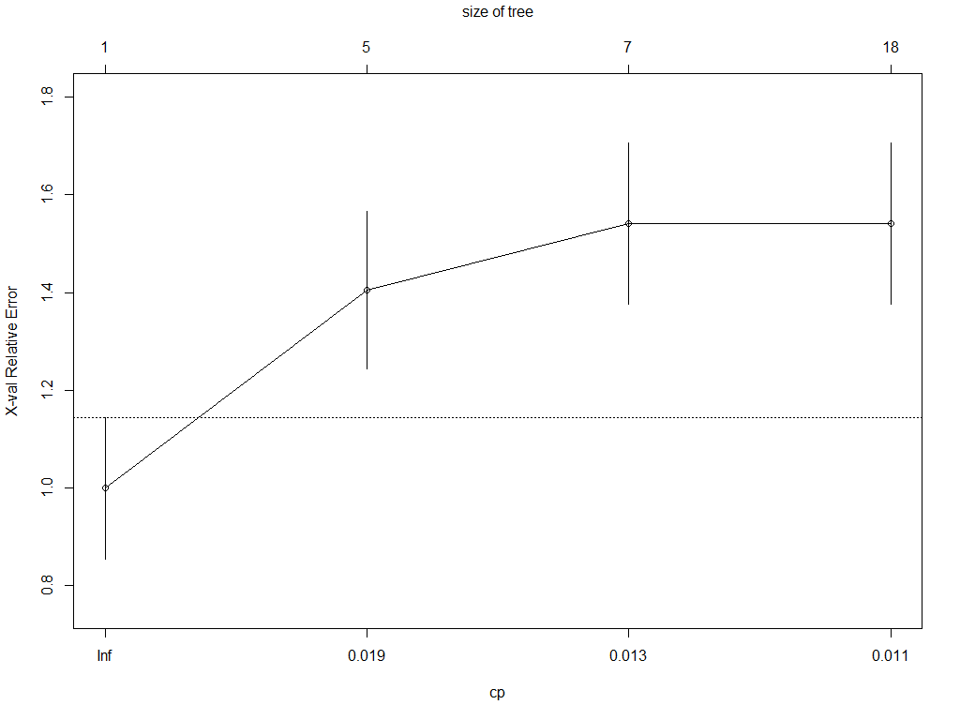
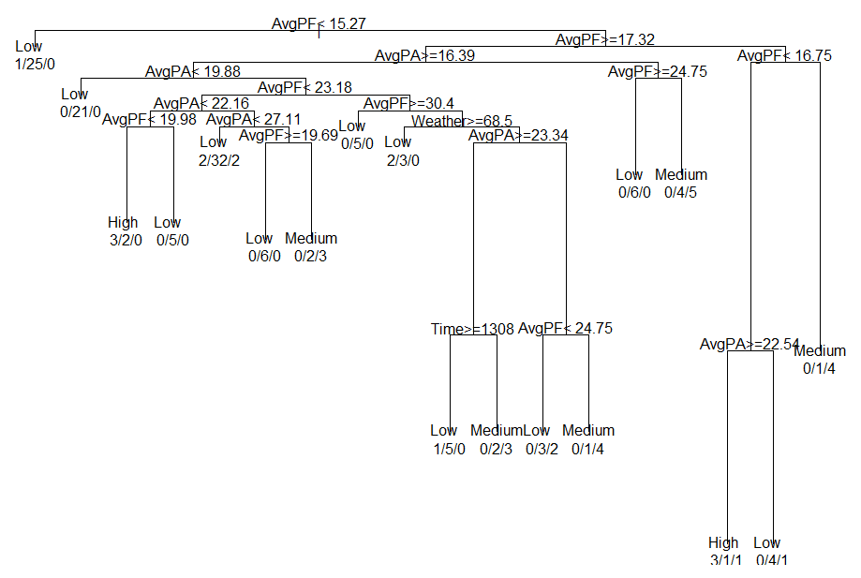

Results: Magnitude of Upset – Classification with Decision Tree

Slide 16
Results: Upset – Classification
Classifier:
Upset
Parameters:
Away or Home (AorH)
Game Time (Time)
Game Weather (Weather)
Average Points For (AvgPF)
Average Points Against (AvgPA)
Spread (Odds)

Slide 17
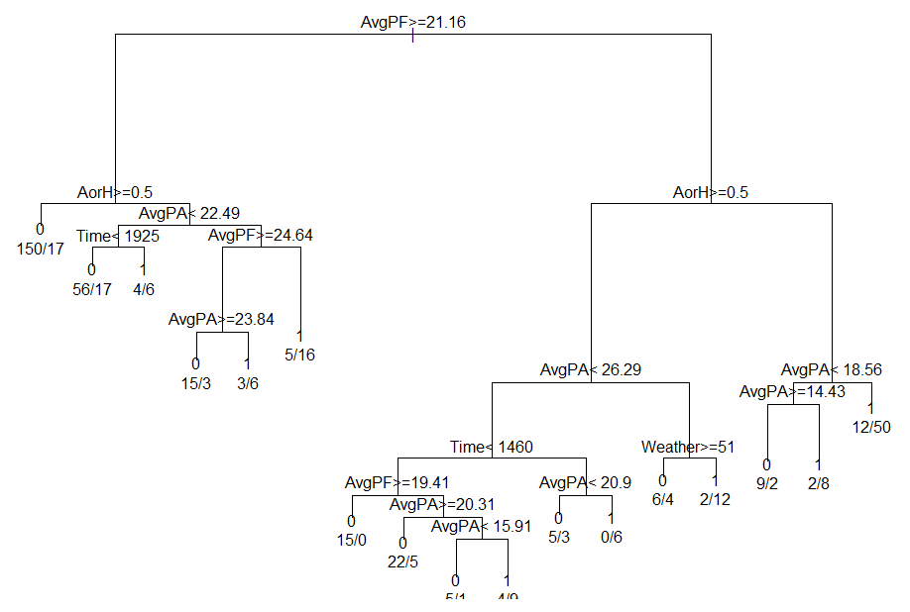
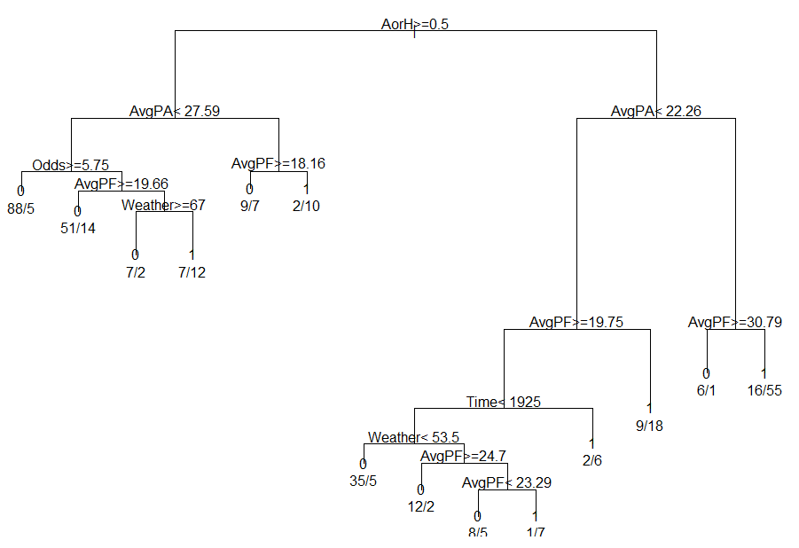
Results: Upset – Classification with Decision Tree (1 of 2)
Previous vs Current Season
All Seasons with 70/30 Partitions

Slide 18
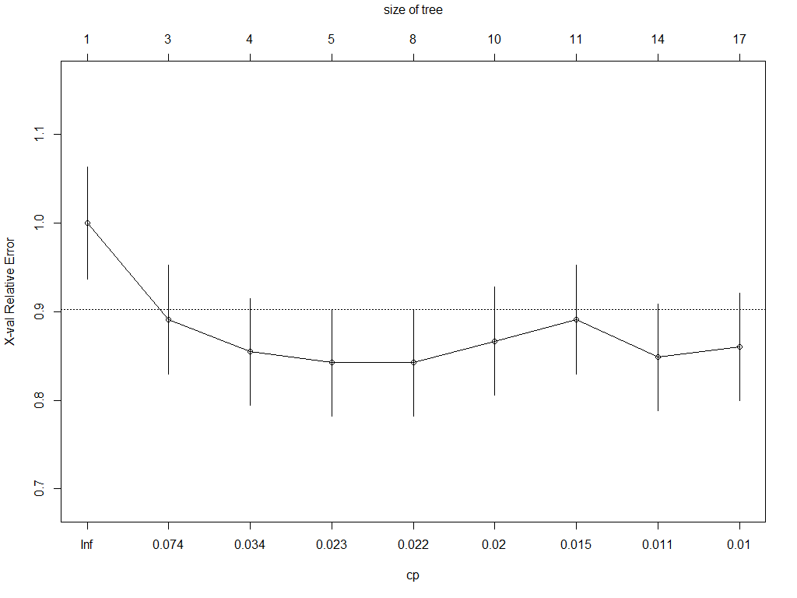
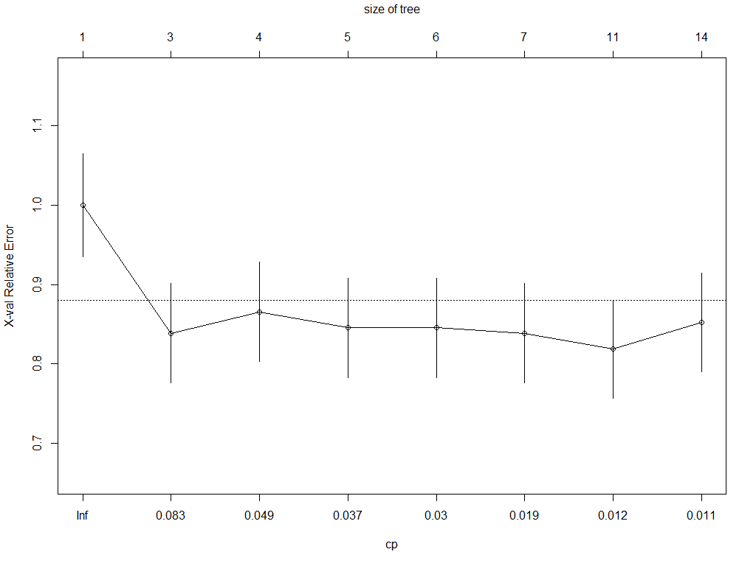


Results: Upset – Classification with Decision Tree (2 of 2)
Notes:
Left: Previous vs Current Season
Right: All Seasons with 70/30 Partitions

Slide 19
Conclusion
No one lone feature
Major role: Away or Home, Average Points For/Against
Rest between games, Weather
Previous /Current Season vs 70/30 Split
Overall Accuracy and Error Rate:
61% and 39% versus 73% and 27%
Sensitivity and Specificity:
57% and 62% versus 59% and 79%
F-measure:
39% Versus 58%
Future
Dissect Average Points For/Against
Isolate Teams
Flag Rivalry Games, Overtime Games
Coach Aspect
Notes:
Accuracy is calculated as the percentage of test samples correctly calculated (TP is true positive, TN is true negative)
Error rate is calculated as the opposite, or 1 - accuracy (FP is false positive, FN is false negative)
Sensitivity is calculated as the true positive (TP) recognition rate
Specificity is calculated as the true negative (TN) recognition rate
Precision is measured as a percentage of the samples classified with a positive label that are actually positive, or exactness
Recall is measured as a percentage of positive samples actually classified with a positive label, or completeness
F-measure is a type of accuracy measurement, which takes into account both precision and recall, with the resulting score assigned is between 0 and 1.

Slide 20
Questions

